Slide 1
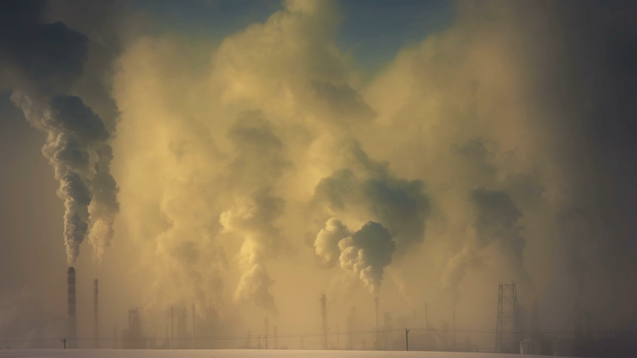
environmental Pollution
An urgent global Issue

Slide 2
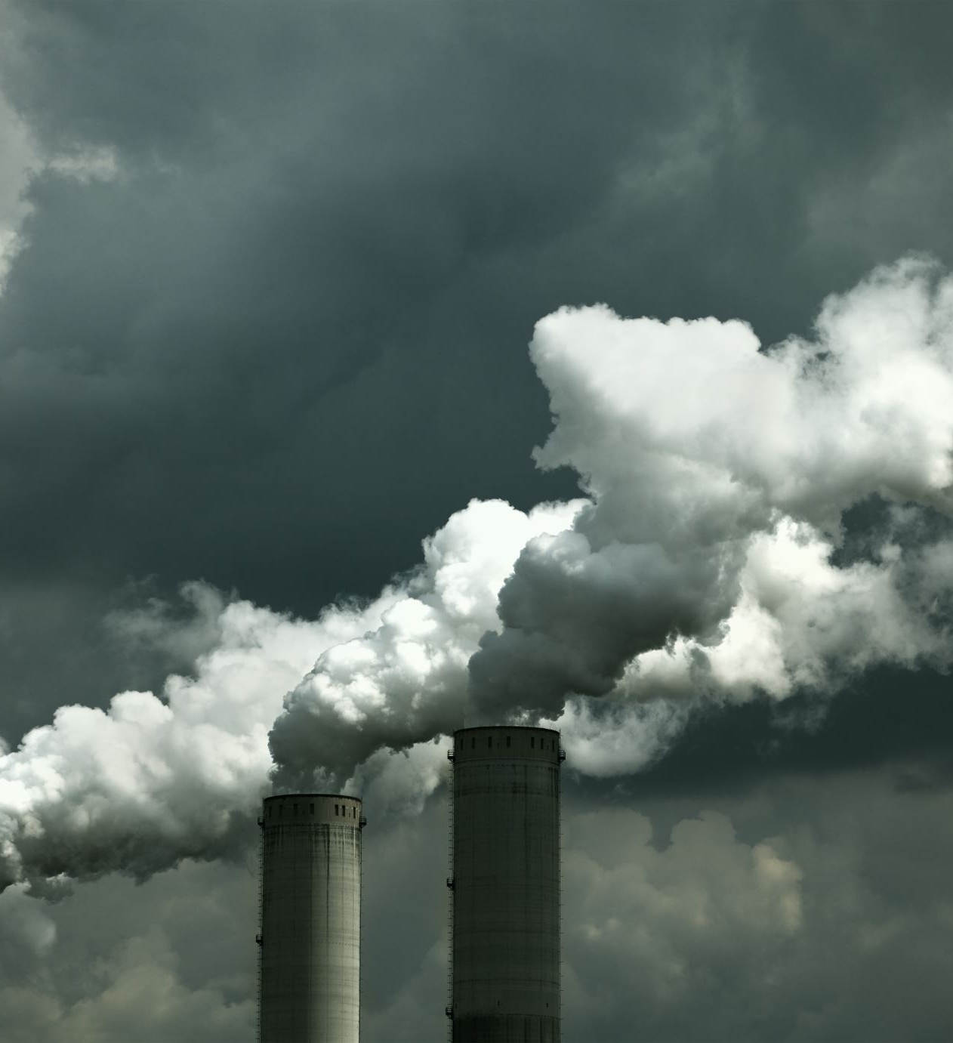
What is environmental pollution Environmental pollution refers to the introduction of harmful substance into the environment that cause negative effect.
Types of Pollution
Air Pollution
Water Pollution
Soil pollution
Noise Pollution
Light Pollution

Slide 3
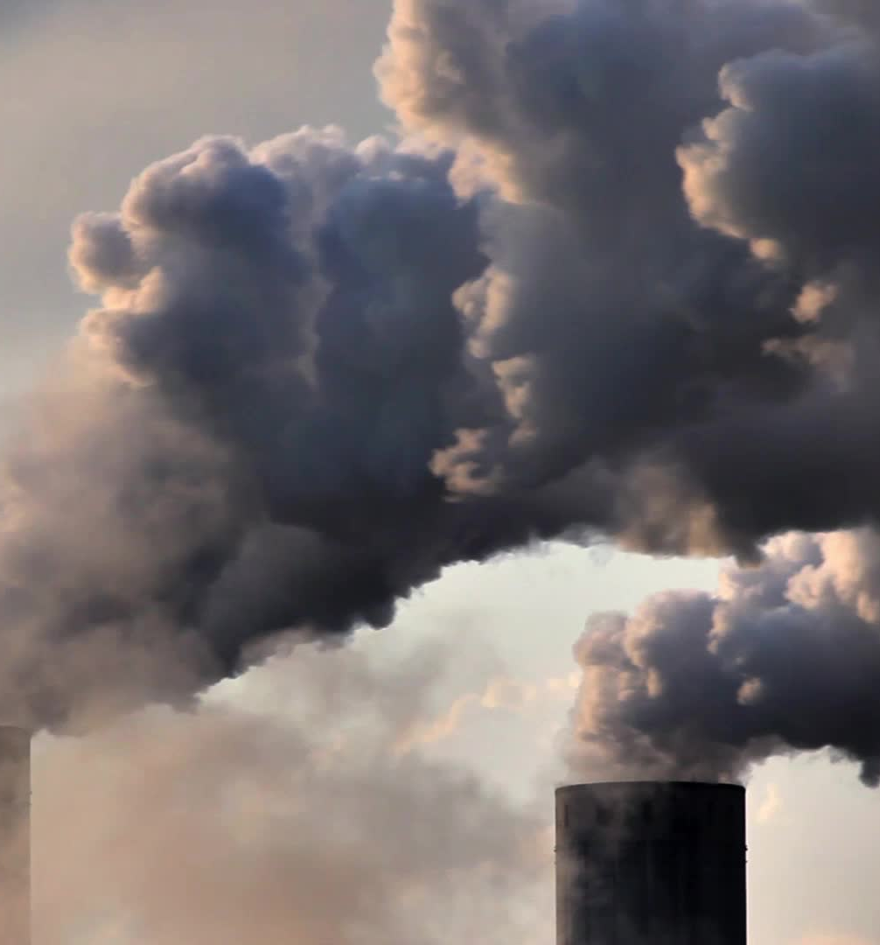
Cause of Environmental Pollutions
Human Activities natural causes
Industrial emissions Volcanic Eruptions
Vehicle emission Wildfire
Deforestation
Agricultural Runoff

Slide 4
Effect of Pollution
Health Risks: Environmental Dam
Raspatory diseases Global Warming(due to air pollution)
Waterborne diseases Ocean acidification(due to water pollution)
Disruption to Ecosystems Loss of biodiversity

Slide 5
Solutions to Combat Pollution
Government Actions Individual actions
Strict environmental regulations Reducing waste
Promotion of renewable energy sources Using eco-friendly products
planting trees

